Slide 1
IT Security and Penetration Testing
Chapter 4
Sniffers

Slide 2
Objectives
Identify sniffers
Recognize types of sniffers
Discover the workings of sniffers
Appreciate the functions that sniffers use on a network
Computer Security and Penetration Testing

Slide 3
Objectives (continued)
List types of sniffer programs
Implement methods used in spotting sniffers
List the techniques used to protect networks from sniffers
Computer Security and Penetration Testing

Slide 4
Sniffers
Sniffer, or packet sniffer
  Application that monitors, filters, and captures data packets transferred over a network
Sniffers are nearly impossible to detect in operation
  And can be implemented from nearly any computer
Types of sniffer
  Bundled
  Commercial
  Free
Computer Security and Penetration Testing

Slide 5
Bundled Sniffers
Come bundled with specific operating systems
Examples
  Network Monitor comes bundled with Windows
  Tcpdump comes with many open source UNIX-like operating systems, like Linux
  Snoop is bundled with the Solaris operating systems
  nettl and netfmt packet-sniffing utilities are bundled with the HP-UX operating system
Computer Security and Penetration Testing

Slide 6
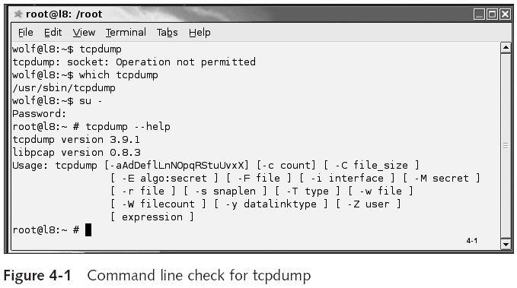
Bundled Sniffers (continued)
Computer Security and Penetration Testing

Slide 7
Commercial Sniffers
Observe, monitor, and maintain information on a network
Some companies use sniffer programs to detect network problems
Can be used for both
  Fault analysis, which detects network problems
  Performance analysis, which detects bottlenecks
Computer Security and Penetration Testing

Slide 8
Free Sniffers
Used to observe, monitor, and maintain information on a network
Can also be used for both fault analysis and performance analysis
Differences between commercial and free sniffers
  Commercial sniffers generally cost money, but typically come with support
  Support on free sniffers is minimal
Computer Security and Penetration Testing

Slide 9
Sniffer Operation
Sniffer must work with the type of network interface
  Supported by your operating system
Sniffers look only at the traffic passing through the network interface adapter
  On the machine where the application is resident
You can read the traffic on the network segment upon which your computer resides
Computer Security and Penetration Testing

Slide 10
Components of a Sniffer
Hardware
  NIC is the hardware most needed
Capture Driver
  Captures the network traffic from the Ethernet connection
  Filters out the information that you don’t want
    And then stores the filtered traffic information in a buffer
Buffer
  Dynamic area of RAM that holds specified data
Computer Security and Penetration Testing

Slide 11
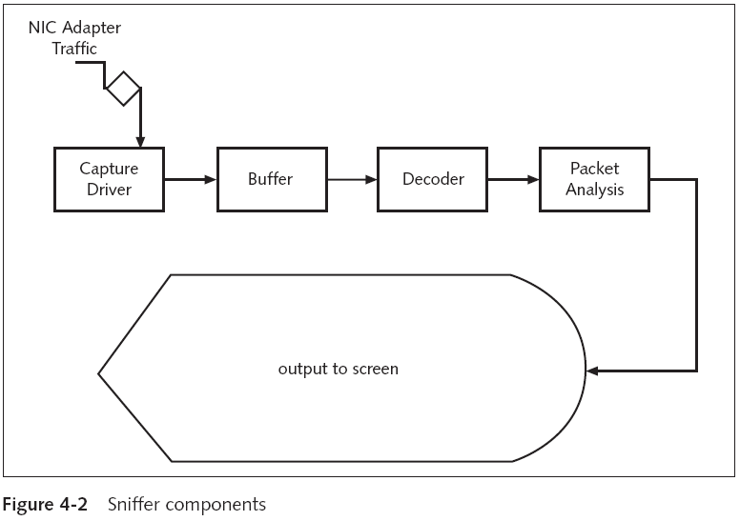
Computer Security and Penetration Testing

Slide 12
Components of a Sniffer (continued)
Buffer (continued)
  Methods of storing captured data
    Stored until the buffer is full with information
    Round-robin method
Decoder
  Interprets binary information and then displays it in a readable format
Packet Analysis
  Sniffers usually provide real-time analysis of captured packets
Computer Security and Penetration Testing

Slide 13
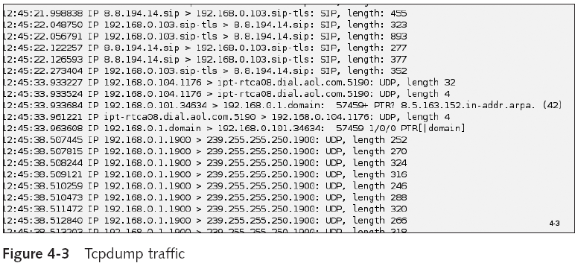
Components of a Sniffer (continued)
Computer Security and Penetration Testing

Slide 14
Placement of a Sniffer
A sniffer can be implemented anywhere in a network
Sniffer is best strategically placed in a location where only the required data will be captured
Sniffers are normally placed on:
  Computers
  Cable connections
  Routers
  Network segments connected to the Internet
  Network segments connected to servers that receive passwords
Computer Security and Penetration Testing

Slide 15
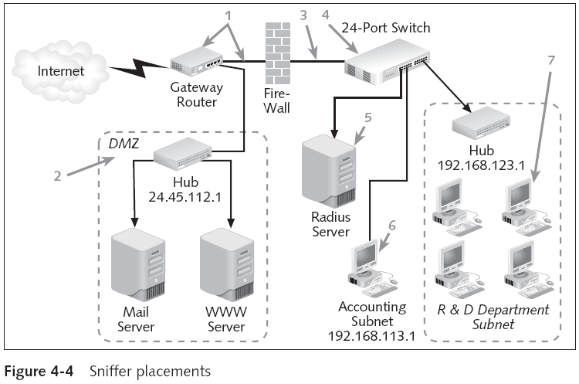
Placement of a Sniffer (continued)
Computer Security and Penetration Testing

Slide 16
MAC Addresses
Media Access Control (MAC) address
  A unique identifier assigned to a computer
  Associated with the NIC attached to most networking equipment
  Distinguishes a computer from the other computers on the network
Computer Security and Penetration Testing

Slide 17
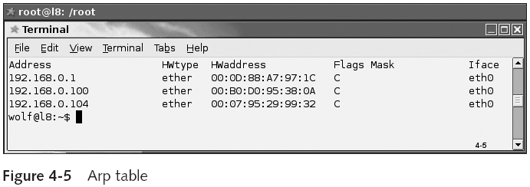
MAC Addresses (continued)
Computer Security and Penetration Testing

Slide 18
Data Transfer over a Network
If a data packet is sent from Alice to Bob
  It must pass through many routers
Routers first examine the destination Internet Protocol (IP) address
  To direct the data packet to Bob
Alice has the information about the first router and the IP address of Bob’s PC
Alice’s computer employs an Ethernet frame to communicate with that router
Computer Security and Penetration Testing

Slide 19
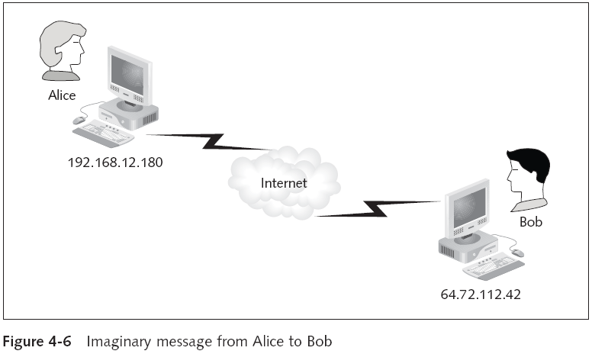
Data Transfer over a Network (continued)
Computer Security and Penetration Testing

Slide 20
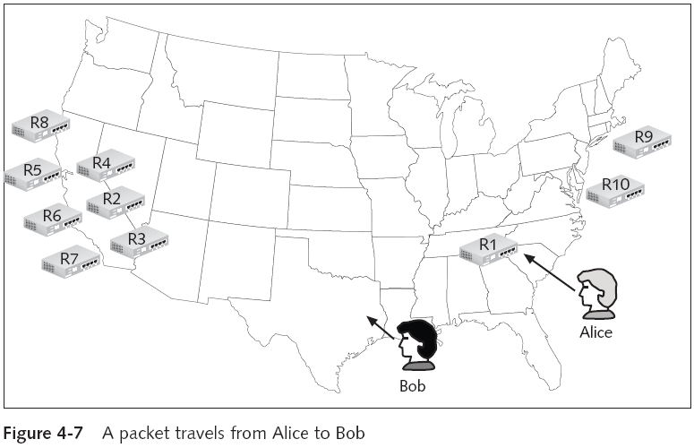
Data Transfer over a Network (continued)
Computer Security and Penetration Testing

Slide 21
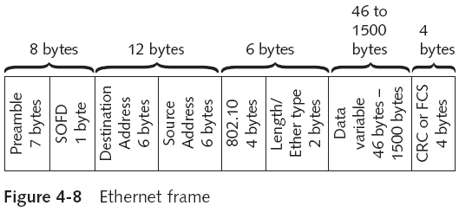
Data Transfer over a Network (continued)
Computer Security and Penetration Testing

Slide 22
Data Transfer over a Network (continued)
Transmission Control Protocol/Internet Protocol (TCP/IP) stack in Alice’s computer
  Generates a frame to transmit the data packet to Bob in Houston
TCP/IP stack then transfers it to the Ethernet module
  Ethernet information is added
Data is sent so that the TCP/IP stack at the opposite end is able to process the frame
CRC checks to verify that the Ethernet frame reaches the destination without being corrupted
Computer Security and Penetration Testing

Slide 23
Data Transfer over a Network (continued)
Frame is sent to the Ethernet cabling within the network or the private LAN
All hardware adapters on the LAN can view the frame
Every adapter then compares the destination MAC address in the frame with its own MAC address
Computer Security and Penetration Testing

Slide 24
The Role of a Sniffer on a Network
Promiscuous mode
  A NIC can retrieve any data packet being transferred throughout the Ethernet network segment
A sniffer on any node on the network can record all the traffic that travels
  By using the NIC’s built-in ability to examine packets
A sniffer puts a network card into the promiscuous mode by using a programmatic interface
Interface can bypass the TCP/IP stack operating systems
Computer Security and Penetration Testing

Slide 25
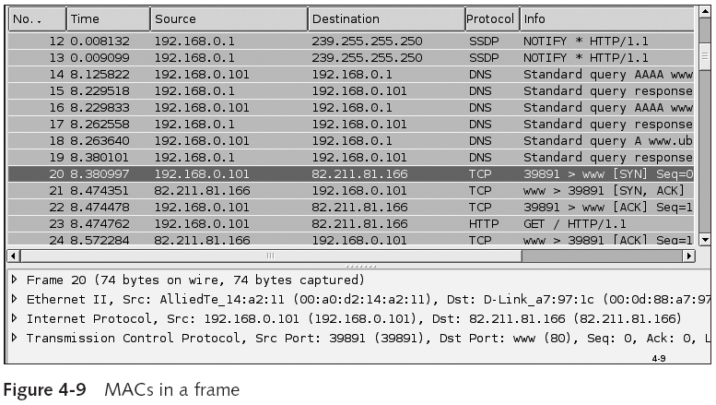
The Role of a Sniffer on a Network (continued)
Computer Security and Penetration Testing

Slide 26
Sniffer Programs
Some sniffer programs are used for monitoring purposes
  Others are written specifically for capturing authentication information
Partially functioned sniffers have fallen out of favor
Computer Security and Penetration Testing

Slide 27
Wireshark (Ethereal)
Probably the best-known and most powerful free network protocol analyzer
  For UNIX/Linux and Windows
Allows you to capture packets from a live network and save them to a capture file on disk
Data can be captured off the wire from a network connection
  And can be read from Ethernet, FDDI, PPP, token-ring, or X.25 interfaces
Computer Security and Penetration Testing

Slide 28
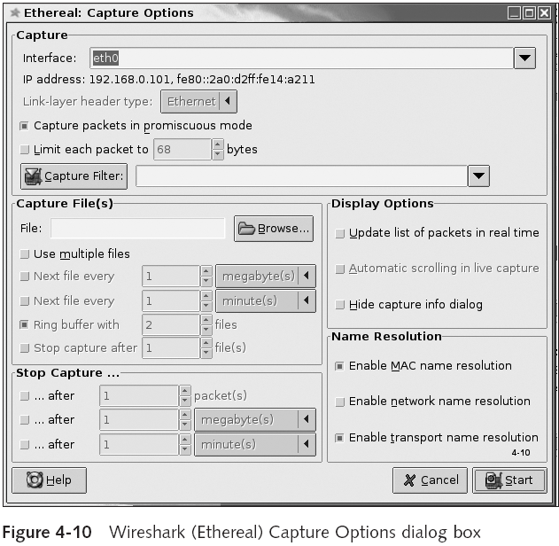
Computer Security and Penetration Testing

Slide 29
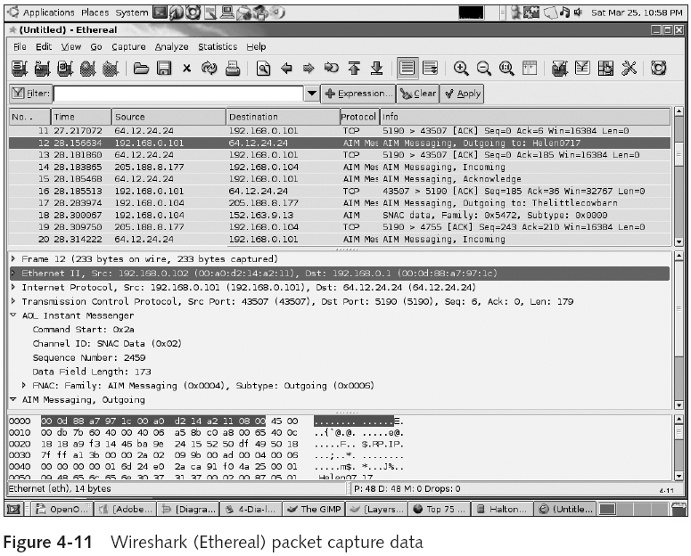
Computer Security and Penetration Testing

Slide 30
Tcpdump/Windump
Most commonly bundled sniffer with Linux distros
Widely used as a free network diagnostic and analytic tool
Configurable to allow for packet data collection based on specific strings or regular expressions
Can decode and monitor the header data of
  Internet Protocol (IP)
  Transmission Control Protocol (TCP)
  User Datagram Protocol (UDP)
  Internet Control Message Protocol (ICMP)
Computer Security and Penetration Testing

Slide 31
Tcpdump/Windump (continued)
Monitors and decodes application-layer data
Can be used for
  Tracking network problems, detecting ping attacks, or monitoring network activities
Commands
  tcpdump (for Linux)
  windump (for Windows)
Computer Security and Penetration Testing

Slide 32
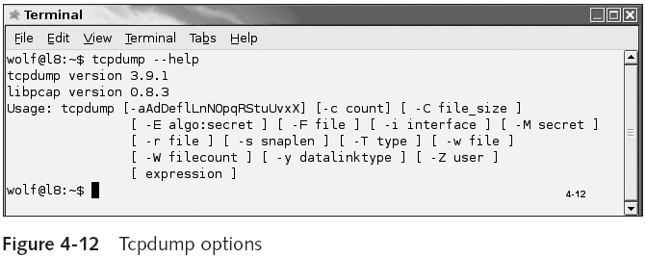
Tcpdump/Windump (continued)
Computer Security and Penetration Testing

Slide 33
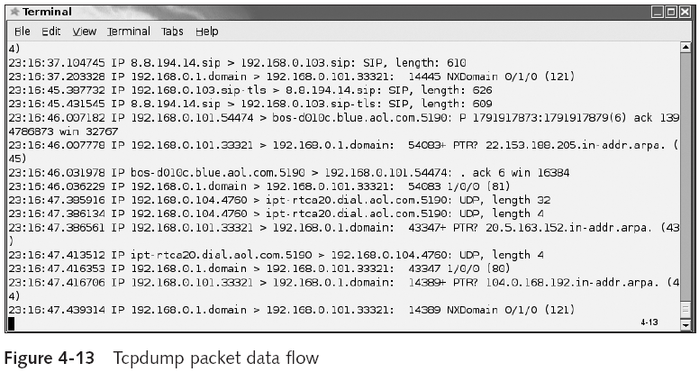
Tcpdump/Windump (continued)
Computer Security and Penetration Testing

Slide 34
Snort
Can be used as a packet sniffer, packet logger, or network intrusion detection system
Logs packets into either binary or ASCII format
Functions include
  Performing real-time traffic analysis
  Performing packet logging on IP networks
  Debugging network traffic
  Analyzing protocol
  Searching and matching content
  Detecting attacks, such as buffer overflows
Computer Security and Penetration Testing

Slide 35
Snort (continued)
Snort works on the following platforms:
  Linux
  Solaris
  Windows NT
  Windows 2000
  Sun
  IRIX
Computer Security and Penetration Testing

Slide 36
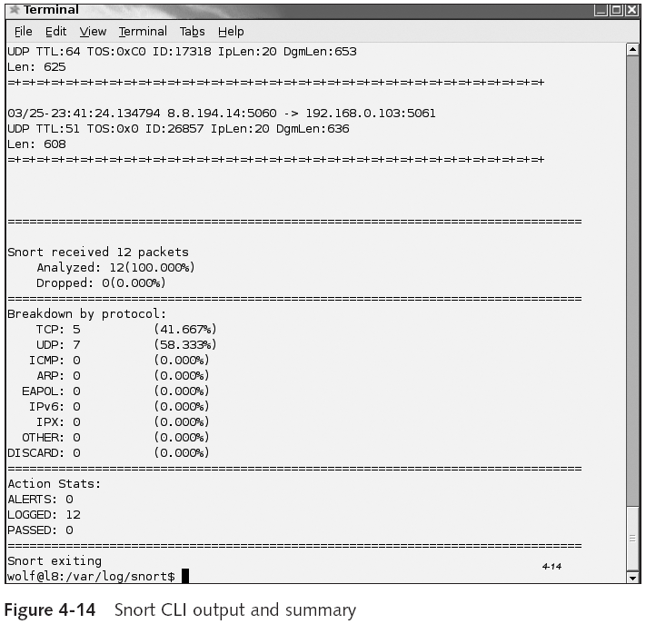
Computer Security and Penetration Testing

Slide 37
Network Monitor
Part of the Microsoft Windows NT, Windows 2000 Server, and Windows 2003 Server
Functions
  Captures network traffic and translates it into a readable format
  Supports a wide range of protocols
  Maintains the history of each network connection
  Supports high-speed as well as wireless networks
  Provides advanced filtering capabilities
Computer Security and Penetration Testing

Slide 38
Gobbler
Antiquated MS-DOS-based sniffer that can run on any system with Windows 95 or Windows NT
Functions that are supported by Gobbler include
  Packet filtering
  Event triggering
Computer Security and Penetration Testing

Slide 39
Ethload
Another MS-DOS terminal-based application
A freeware packet sniffer that was written in the C language for Ethernet and token-ring networks
Cannot be used to sniff rlogin (UNIX-style remote access) and Telnet sessions
Ethload analyzes the following protocols:
  TCP/IP, DECnet, OSI, XNS, NetWare, and NetBios Extended User Interface (NetBEUI)
Computer Security and Penetration Testing

Slide 40
Esniff
Written in the C language by the hacker known as “rokstar”
Designed to sniff packets on SunOS by Sun Microsystems
Captures only the first 300 bytes of each packet
  Including the username as well as the password
Esniff can support the following protocols:
  Telnet, FTP, rlogin
Computer Security and Penetration Testing

Slide 41
Dsniff
Suite of powerful network auditing and penetration-testing tools last updated in May 2002
Includes many tools that allow you to
  Passively monitor a network
    Using filesnarf, dsniff, mailsnarf, msgsnarf, urlsnarf, or Webspy
  Intercept network traffic
    Using Arpspoof, dnsspoof, and macof
  Perform man-in-the-middle attacks
    Via sshmitm and webmitm
Computer Security and Penetration Testing

Slide 42
Sniffit
Network protocol analysis and monitoring tool last updated in February 2005
Captures TCP, UDP, and ICMP packets
Can be configured to filter incoming packets
Can handle Ethernet and Point-to-Point Protocol (PPP) devices
Computer Security and Penetration Testing

Slide 43
Sunsniff
Written in the C language
Sniffer program written specifically for Sun Microsystems operating systems
Computer Security and Penetration Testing

Slide 44
Linux_sniffer
Written in the C language
Linux-specific sniffer
It is of interest mostly for historical reasons
Computer Security and Penetration Testing

Slide 45
Sniffer Pro
Commercial product created by Network Associates, Inc.
Easy-to-use interface for capturing and viewing network traffic
Captures important authentication information
  Usernames and passwords
Computer Security and Penetration Testing

Slide 46
EtherPeek NX
WildPackets’ Windows-based expert Ethernet network analyzer
Provides network engineers with expert diagnostic
A commercial sniffer with a clean and useful interface
Many features and technological innovations
  Real-time expert analysis on multiple adapters
  Application Response Time (ART) analysis
  Extensive application protocol decoding
Computer Security and Penetration Testing

Slide 47
Fluke Networks Protocol Analyzers
Fluke Networks is a provider of network tools
  Its focus is on selling physical tools for network analysis rather than selling only software
Advantage of using an appliance
  Impossible to mishandle the installation of the software if it is on a dedicated appliance
    With only one purpose or user
Disadvantage of using an appliance
  Locks you into the appliance designer’s architecture and vision
Computer Security and Penetration Testing

Slide 48
Detecting a Sniffer
Since sniffer technology is passive
  It is difficult to detect sniffers
You can only detect whether or not the suspect is running his or her NIC in promiscuous mode
Tools available to check for sniffers
  AntiSniff
  SniffDet
  Check Promiscuous Mode (cpm)
  Neped.c
  Ifstatus
Computer Security and Penetration Testing

Slide 49
DNS Test
Some sniffers perform DNS lookups
  In order to replace IP addresses in their logs with fully qualified host names
Many tools exist to detect sniffers using this method
Computer Security and Penetration Testing

Slide 50
Network Latency Tests
Several methods use the delay in network latency to determine a host’s likely sniffer activity
It is possible to “measure” which of the machines are working harder
  “Hard workers” are potential sniffer hosts
Computer Security and Penetration Testing

Slide 51
Ping Test
Use AntiSniff to perform this test
Antisniff can send a packet that contains a legitimate IP address, but a fake MAC address
  If a host responds to a ping with a fake MAC address, it must mean that that host is in promiscuous mode
Computer Security and Penetration Testing

Slide 52
ARP Test
When in promiscuous mode, the Windows driver for the network card
  Examines only the first octet of the MAC address to determine whether it is a broadcast packet
Antisniff can send a packet with a MAC address of ff:00:00:00:00:00 and the correct destination IP address of the host
  Causing the Microsoft OS to respond while in promiscuous mode
Computer Security and Penetration Testing

Slide 53
Source-Route Method
Uses a technique known as the loose-source route
  To locate sniffers on nearby network segments
Adds the source-route information inside the IP header of packets
  Routers ignore the destination IP address
    And forward the packet to the next IP address in the source-route option
Computer Security and Penetration Testing

Slide 54
Decoy Method
Involves setting up a client and a server on either side of a network
Server is configured with accounts that do not have rights or privileges
  Or the server is virtual
Client runs a script to log on to the server by using the Telnet, POP, or IMAP protocol
Hackers can grab the usernames and passwords from the Ethernet
  And attempt to log on to the server
Computer Security and Penetration Testing

Slide 55
Commands
Check if you are running in promiscuous mode
  ifconfig -a
Check if you are running a sniffer on your own computer
  ps aux
Computer Security and Penetration Testing

Slide 56
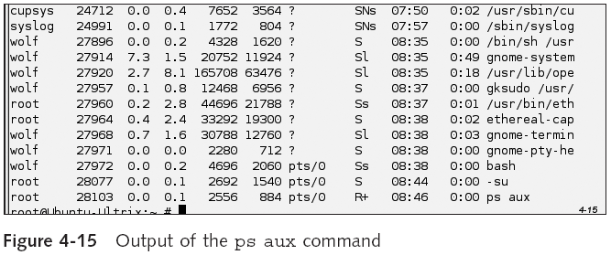
Commands (continued)
Computer Security and Penetration Testing

Slide 57
Time Domain Reflectometers (TDR) Method
Sends an electrical pulse in the wire and creates a graph based on the reflections that emanate
Provides distance information in a numerical format
TDR can detect hardware packet sniffers attached to the network that are otherwise silent
Computer Security and Penetration Testing

Slide 58
Protecting Against a Sniffer
The heart of defense against a sniffer is to make the data inconvenient to use
Encourage the use of applications that use standards-based encryption, such as:
  Secure Sockets Layer (SSL)
  Pretty Good Privacy (PGP) and Secure/Multipurpose Internet Mail Extensions (S/MIME)
  Secure Shell (SSH)
Computer Security and Penetration Testing

Slide 59
Secure Socket Layer (SSL)
Designed by Netscape
Provides data security between application protocols
Secure Sockets Layer, or SSL
  Nonproprietary protocol providing data encryption, server authentication, message integrity, and client authentication for a TCP/IP connection
SSL is built as a security standard into all Web browsers and servers
SSL comes in two forms, 40-bit and 128-bit
Computer Security and Penetration Testing

Slide 60
Pretty Good Privacy (PGP) and Secure/Multipurpose Internet Mail
Extensions (S/MIME)
E-mail messages can be sniffed at various points
Basic requirements for securing e-mail messages
  Privacy
  Authentication
Methods that ensure the security of e-mail messages
  PGP
  S/MIME
Computer Security and Penetration Testing

Slide 61
Secure Shell (SSH)
Secure alternative to Telnet
SSH protects against:
  IP spoofing
  Spoof attacks on the local network
  IP source routing
  DNS spoofing
  Interception of cleartext password
  Man-in-the-middle attacks
Computer Security and Penetration Testing

Slide 62
More Protection
At OSI layer-2
  Enable port security on a switch
  Enforce static ARP
At OSI layer-3
  IPSEC paired with secure, authenticated naming services (DNSSEC)
Firewalls can be a mixed blessing
  Sniffers are most effective behind a firewall, where legacy cleartext protocols are often allowed by corporate security policy
Computer Security and Penetration Testing

Slide 63
Summary
A sniffer, or packet sniffer, is an application that monitors, filters, and captures data packets transferred over a network
Bundled sniffers come built into operating systems
Nonbundled sniffers are either commercial sniffers with a cost of ownership or free sniffers
The components of a sniffer are hardware, capture driver, buffer, decoder, and packet analysis
Sniffers need to be placed where they will get the smallest aggregate network traffic
Computer Security and Penetration Testing

Slide 64
Summary (continued)
The standard behavior in a TCP/IP network that sniffers exploit is that all packets are passed to all the nodes in the subnet
Sniffers change the NIC operation mode to promiscuous mode
Wireshark (Ethereal),Tcpdump/Windump, Snort, and Network Monitor are all modern packet sniffers
Sniffit works on SunOS, Solaris, UNIX, and IRIX
Sniffer Pro, EtherPeek NX, and Fluke Networks Protocol Analyzers are examples of commercial packet sniffers
Computer Security and Penetration Testing

Slide 65
Summary (continued)
Several tools exist, or have existed, to detect a sniffer
All tools for protecting your network from a packet sniffer involve some level of encryption
Computer Security and Penetration Testing

